Slide 1
18 open datasets, APIs and open source projects you can start hacking today
Charles Duncan - @duncanreporting
Get this presentation at github.com/duncancc/citycamp14

Slide 2

docHive: structured data from PDFs
Uses Rails, Tesseract, ImageMagick
Extract structured data from image-based PDF files
Liberate data, make it usable
github.com/thuncan/dhgit
Developed by Raleigh Public Record

Slide 3
NC Dept. of Public Instruction
State-wide school data
Testing scores and graduation rates
Demographic and economic data
Info goes down to the individual school level over many years
Compare school performance in counties or across the state
Make an app so users can build their own comparisons
ncpublicschools.org/data/reports/

Slide 4

Give me all the education data
National Center for Education
Statistics
Go beyond North Carolina for
education statistics to
compare, contrast across
other counties, states and countries
http://nces.ed.gov/datatools/index.asp?DataToolSectionID=4

Slide 5
Sunlight’s Open States API
Info on all 50 state legislatures plus DC and Puerto Rico
Figure out what’s going on in the North Carolina General Assembly
Make the NCGA actions easier to keep track of and more accessible to the public
sunlightfoundation.com/api

Slide 6
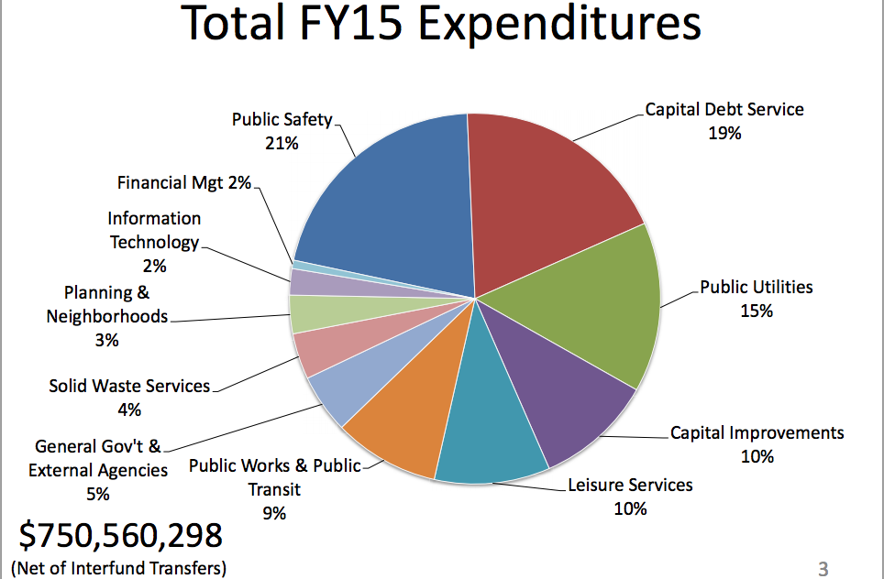
Hack a city budget
Municipal budgets
are hard to understand
Get the data, open it up
Track income and expenses
over time
Make an app to make presenting budget info easier to present
Several good projects on GitHub to get you started

Slide 7
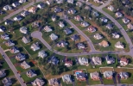
Census data, but better
Clean US Census data
Bulk download and access via Javascript to 2010 Census data from Investigative Editors and Reporters
Build demographic data into your
apps without dealing with
the super fun data cleaning
census.ire.org/

Slide 8
New Medicare data!
Centers for Medicare & Medicaid
Recently released data from the feds on doctor billing for Medicare Part B
Compare NC doctors, hospitals etc.
www.cms.gov/Research-Statistics-Data-and-Systems/Statistics-Trends-and-Reports/Medicare-Provider-Charge-Data/Physician-and-Other-Supplier.html

Slide 9
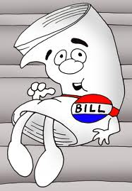
“I’m just a bill” – NCGA style
RSS feeds for bills in the North Carolina House and Senate
Track bills as they’re filed and for new activity
Use the URL format to scrape the NCleg.net site
www.ncleg.net/gascripts/LastAction/LastAction.pl?Biennium=2013&SessionNumber=2&ViewType=RSS
www.ncleg.net/gascripts/BillLookUp/BillLookUp.pl?Session=2013&BillID=H227&view=history_rss

Slide 10
Statewide GIS data
§ 132-10. Qualified exception for geographical information systems.
Geographical information systems databases and data files developed and operated by counties and cities are public records within the meaning of this Chapter. The county or city shall provide public access to such systems by public access terminals or other output devices…
Wake County: wakegov.com/gis/services/Pages/data.aspx
Mecklenburg: http://maps.co.mecklenburg.nc.us/openmapping
State level: cgia.state.nc.us

Slide 11

Track political ad buys
Data now available online from the FCC in some markets to track political ad buys
The “political file” is a public record and gives expenditures by parties, elections etc.
This is an election year, lots of money will be going around to influence voters
I would love an app that could tell me who paid for a political commercial when it comes on TV
Ex: stations.fcc.gov/station-profile/wral-tv/political-files/browse-%3E2014
API: stations.fcc.gov/developer/

Slide 12
Planning nerds unite!
Streetmix is an interactive street section builder that helps community members mockup the streets they'd like to live on and offer these mockups as future plans for city officials and planners.
Redeploy for your town or build on top of it to help increase public participation in the planning process
streetmix.net
github.com/codeforamerica/streetmix

Slide 13
Water can kill you
Every summer lakes are closed to swimming because of bacteria
Track which lakes are open, which could close and the overall quality
Integrate swimming hole reviews and other cool stuff
Keep kids from getting E. coli swimming in polluted lakes
Wake Co. data updated weekly. What’s available for your community?
wakegov.com/water/recreational/Pages/data.aspx

Slide 14
Scrape all the sites
Wanna build an app? You’re gonna need data.
Useful tool for your web-scraping pleasure
Extract data from websites, PDFs, Twitter
Leave your scraper running from the cloud
scraperwiki.com
You will thank me for this

Slide 15
OpenBlock is awesome
Web application and RESTful service that allows users to browse and search their local area for "hyper-local news" - to see what's going on recently in the immediate geographic area.
Connect to data coming out of local gov in your area, make it accessible
Anything with a date and location, add it to OpenBlock
github.com/openplans/openblock

Slide 16
Include weather in your app
Building an app for travel, parks, bike paths, etc.?
Feed local weather data into your app
XML data feeds for, basically, everywhere
Current and historical data
There are 92 weather stations in NC sending out data
Your tax dollars at work
weather.gov
http://w1.weather.gov/xml/current_obs/

Slide 17

Think of the puppies!
PetFinder API!
Access Petfinder's database of over 300,000 adoptable pets and 11,000 animal welfare organizations.
Use the API to create your own dynamic pet web sites or applications.
petfinder.com/developers/api-docs

Slide 18
Open Raleigh
Open data site for the City of Raleigh
Data on…Police and fire
Planning and development
The city budget
And much more
Hack it, play with it, visualize it, make it accessible
data.raleighnc.gov/

Slide 19
Build an open data site for your community
Put all the available open datasets from your city or county in one place
Advocate for an open data policy from your political leaders
Work to create a culture of open data
Examples…
data.raleighnc.gov/
opendatacatalog.ashevillenc.gov/

Slide 20
More ideas for brainstorming
codeforamerica.org/apps/
sunlightfoundation.com/api/
propublica.org/tools/
ncopenbook.gov
data.gov
Get this presentation at github.com/duncancc/citycamp14
Charles Duncan – @duncanreporting
Editor, Raleigh Public Record

